Slide 1
Servlets and JSP

Slide 2
Outline
Overview of Web Application
HTTP Methods and Responses
Life Cycle of Web Servlets
Writing Servlet programs with Servlet APIs
Reading and Processing Forms
Handling GET/POST Requests
Database connectivity through servlets
Cookies and Sessions

Slide 3
Web Application
A web application is a computer program that utilizes web browsers and web technology to perform tasks over the Internet.
Web applications are usually coded in browser-supported language such as JavaScript and HTML as these languages rely on the browser to render the program executable
The web application requires a web server to manage requests from the client, an application server to perform the tasks requested, and, sometimes, a database to store the information

Slide 4
Benefits of a web application
Web applications run on multiple platforms regardless of OS or device as long as the browser is compatible
All users access the same version, eliminating any compatibility issues
They are not installed on the hard drive, thus eliminating space limitations
They reduce software piracy in subscription-based web applications (i.e. SaaS)
They reduce costs for both the business and end user as there is less support and maintenance required by the business and lower requirements for the end user’s computer

Slide 5
HTTP Methods
The primary or most commonly-used HTTP methods are POST, GET, PUT, and DELETE
These methods correspond to create, read, update, and delete (or CRUD) operations, respectively
There are a number of other methods, too, but they are utilized less frequently.

Slide 6
GET
The HTTP GET method is used to read (or retrieve) a representation of a resource
GET requests are used only to read data and not change it. So, they are considered safe
Example: jsonplaceholder.typicode.com/comments?postId=1
Browsers in default make GET request
You can easily test GET request using browser

Slide 7
POST
The POST method submits an entity to the specified resource, often causing a change in state or side effects on the server
DELETE
If a DELETE method is successfully applied, there are several response status codes possible:

Slide 8
PUT
The HTTP PUT request method creates a new resource or replaces a representation of the target resource with the request payload.
The difference between PUT and POST is that PUT is idempotent: calling it once or several times successively has the same effect (that is no side effect), whereas successive identical POST requests may have additional effects, akin to placing an order several times.

Slide 9
HTTP Methods (contd...)
Method | Description
GET | The HTTP GET method is used to read (or retrieve) a representation of a resource GET requests are used only to read data and not change it. So, they are considered safe
POST | The POST method is most often utilized to create new resources POST is not a safe operation. Making two identical POST requests will most likely result in two resources containing the same information but with different identifiers
PUT | PUT is used to modify resources
DELETE | DELETE is used to delete a resource identified by filters or ID

Slide 10
Introduction to Servlets
Servlets are Java-based web components that extend the capabilities of servers to generate dynamic content and handle client requests.
They follow the Java Servlet API specification and are a key part of Java EE (Enterprise Edition).

Slide 11
Life Cycle Overview
Initialization:
Servlet container loads and initializes the servlet when the first request is received.
init() method is called during initialization.
Handling Requests:
Servlet handles multiple requests concurrently through multithreading.
service() method is invoked for each request, delegating to doGet() or doPost() based on the request type.
Termination:
Servlet container calls destroy() method when shutting down or reloading the web application.
Cleanup operations are performed in the destroy() method.

Slide 12
Methods in Servlet Life Cycle
init(ServletConfig config) Method:
Initializes the servlet with the configuration data.
Called once during the servlet's life cycle.
service(ServletRequest req, ServletResponse res) Method:
Invoked for each request.
Determines the type of request (GET, POST, etc.) and delegates to the appropriate method (doGet(), doPost()).
destroy() Method:
Called once during the servlet's life cycle.
Performs cleanup operations before the servlet is unloaded.

Slide 13
Writing Servlet Programs with Servlet APIs
Import Statements:
Import necessary classes from the javax.servlet package.
Extending HttpServlet:
Servlet classes extend HttpServlet to handle HTTP requests.
Overriding Methods:
Override doGet() or doPost() methods to handle specific request types

Slide 14
Handling Requests and Sending Responses
Request and Response Objects:
Use HttpServletRequest to retrieve client data.
Use HttpServletResponse to send data back to the client.

Slide 15
Reading and Processing Forms
HTML Forms:
HTML forms allow users to submit data to a server.
Elements like text fields, checkboxes, radio buttons, and buttons are used in forms.
Servlet Form Handling:
Form Submission: Forms are submitted to the server using the POST or GET method.
Processing Form Data in Servlets: Retrieve form data using request.getParameter() method.
Example: Demonstrate a servlet that reads and processes form data.

Slide 16
Handling GET/POST Requests
GET vs POST:
GET requests append data to the URL.
POST requests send data in the request body.
HttpServlet Methods:
doGet() Method:
Invoked for HTTP GET requests.
Used to retrieve data from the server.
doPost() Method:
Invoked for HTTP POST requests.
Used to submit data to the server.

Slide 17
Database Connectivity Through Servlets
Use JDBC to establish a connection to the database.
Load JDBC driver, create a connection, and obtain a statement.
Use PreparedStatement to execute SQL queries.
Secure way to handle parameters in queries.

Slide 18
Cookies and Sessions
Cookies
Small pieces of data stored on the client's browser.
Retaining user-specific information between requests
Session
HttpSession interface is used for session management.
Allows the server to store and retrieve user-specific information

Slide 19
Handling Cookies and Sessions in Servlets
Creating Cookies:
Use Cookie class to create cookies and add them to the response.
Managing Sessions:
Use HttpSession to store and retrieve session data.

Slide 20
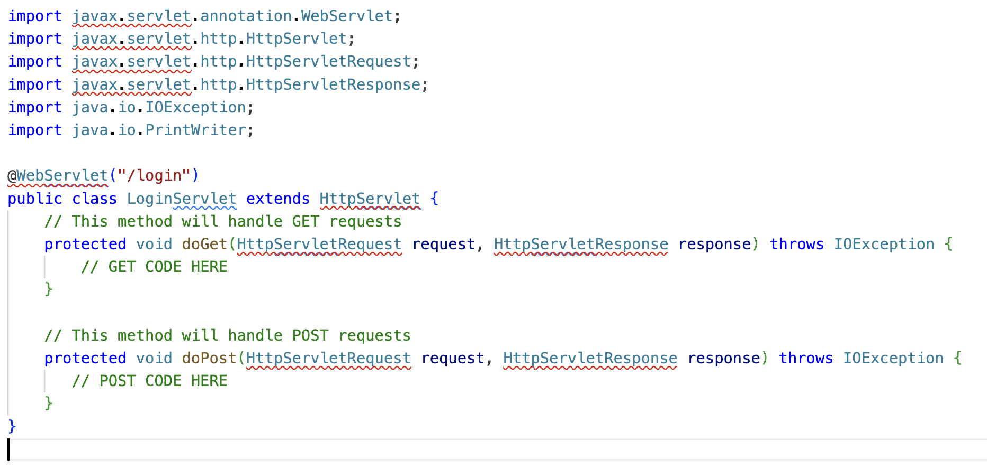
Servlet: Example

Slide 21
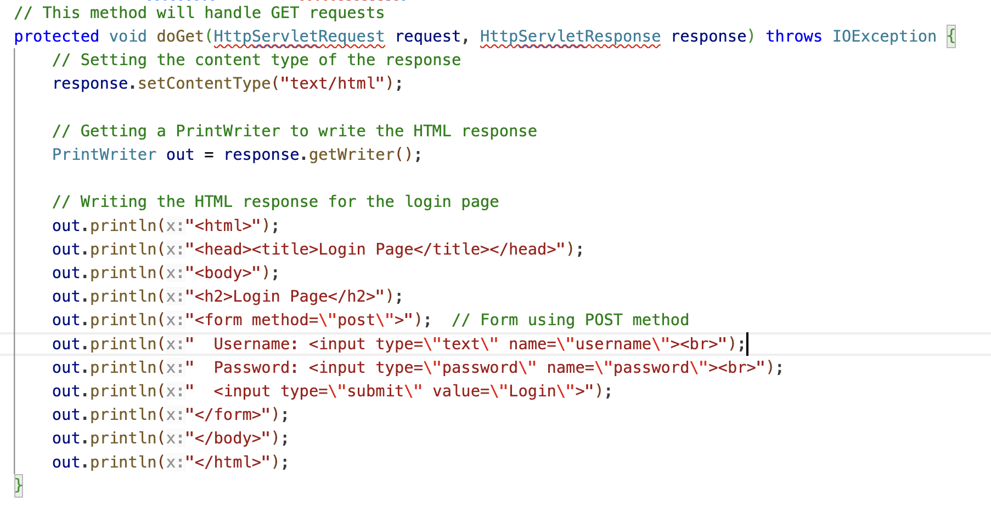
doGet()

Slide 22
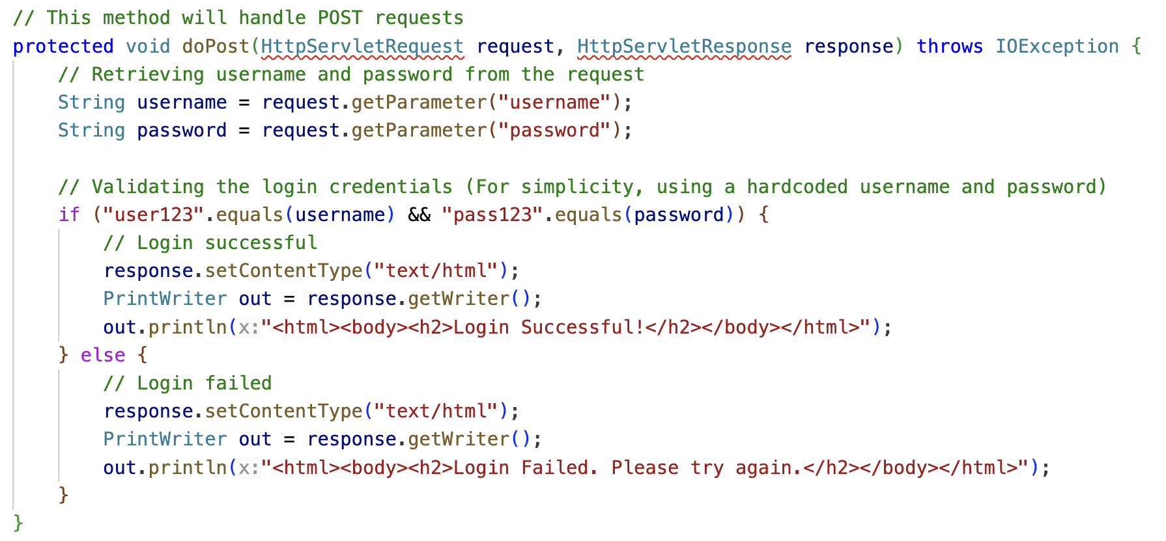
doPost()

Slide 23
Thank You

